Slide 1

Customer Service Improvements through Technology
Becky Jamieson, Director of Corporate Services/Clerk
Lori Bowers, Director of Community Services
Notes:
Our customer service journey

Slide 2
Our Ultimate Goal
Harnessing technology to improve the customer experience
when a resident interacts, attends or participates in a Township service or program providing them a responsive, satisfying and enjoyable experience.

Slide 3
Objectives and Challenges
Enhancing customer service providing timely services with online options
Online enhancements will increase internal efficiencies by eliminating manual paper-based processes
Reduce time to delivery
Connect department knowledge and workflows
Ready systems for future integration and improvements
Knowledge loss
Outdated systems lack integration
No data tracking
The Problem
Customer expectations changing
Siloed departments
Reliant on paper base
Notes:
Will help reduce department silos. Important to note that department experts will need to handle all escalations first and second point of contact when knowledge articles and first point of contact can’t answer the Inquiry/Concern. Goal is to reduce the number of transferred calls. First point of contact to answer FAQ’s by using the knowledge base articles and Common FAQ’s, as well as the history in the CRM if they are following up.
Many municipalities are rightly considering moving services online because customer expectations have changed. Not only has COVID reduced the desire for personal interactions and shown how offering services digitally can work, but the reality is also that many citizens today rely on their devices as a way of life.
We have all moved from the situation 25 years ago – where booking a flight was so complex, you needed a travel agent to do it for you – to a world in which you can book your own flight with a few taps on your smartphone from anywhere and at any time.
Think of all the service industries and about how technology/digital has changed them:
Finance – Online and smartphone banking, online trading.
Exercise – Online classes.
Education – Online school, remote tutoring.
Unquestionably, we are in the smartphone and internet era and this has changed customers’ expectations about what service looks like today. Delivering online has become the way that services are delivered in the 21st century.
However we at the township need offer services in multiple ways including online, in person and phone, now and into the future.
To increase internal efficiencies by eliminating manual paper-based processes through automation
To improve and enhance the customer experience by providing timely services through online options available 24/7/365
To limit knowledge loss by providing a knowledge repository as well as knowledge base articles where all related information is easily accessible and available to both the residents and internal staff of the Townships.
To be aware how there is a need to continue to keep pace with technology and Covid19 both identified the need to find alternate ways to deliver services

Slide 4

Feedback
from Internal
and
Public prior
and during Implementation
Notes:
Strategic plan directive – commitment to continue to update and modernize service delivery through corporate IT strategy
IT Strategy Workshops with staff
Speak up Scugog and communications campaign
Council sessions
Demos
Open sessions

Slide 5
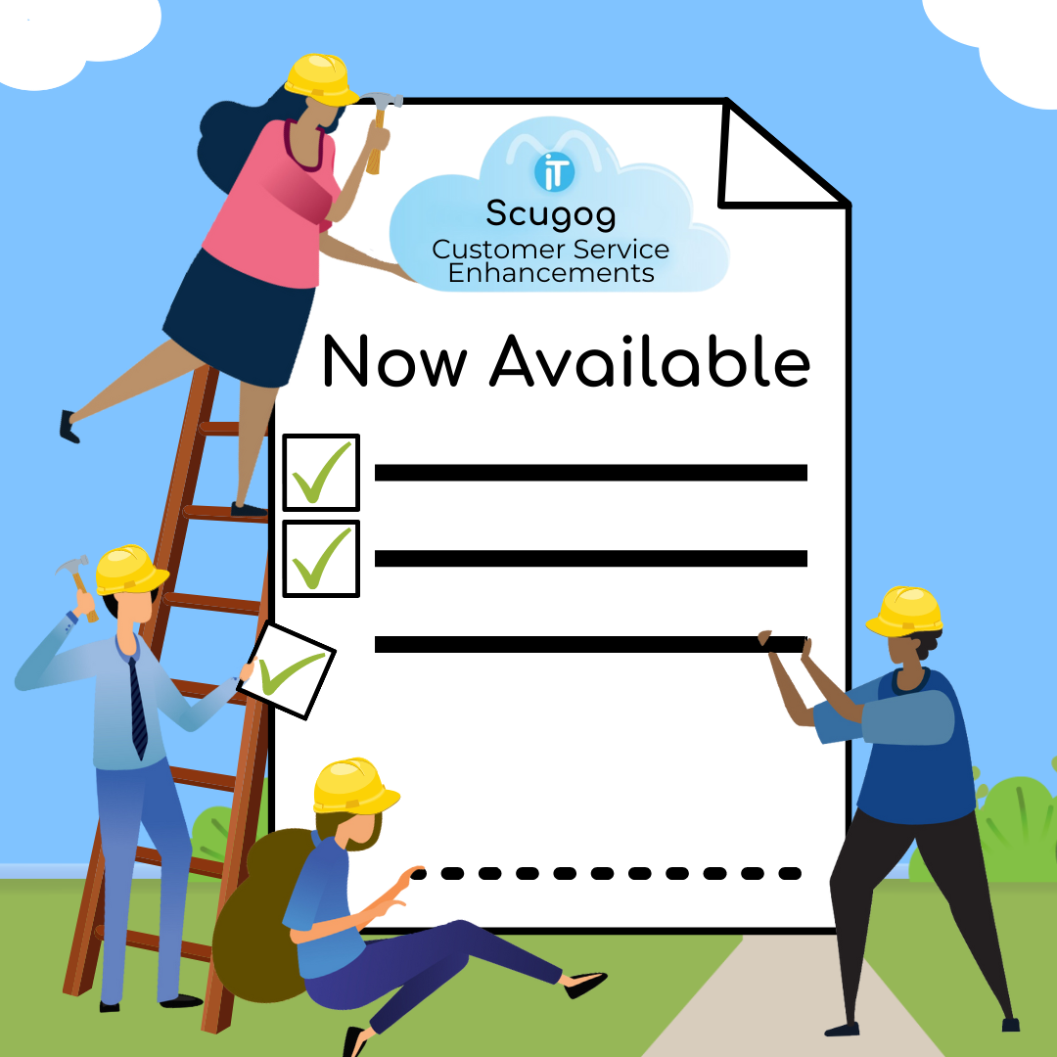
Our
Journey
Notes:
- step by step and continue to communicate as things evolve

Slide 6
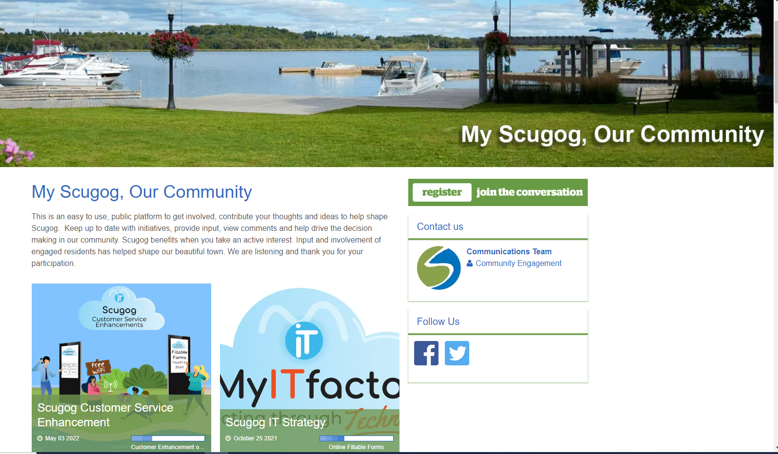
Notes:
stats

Slide 7

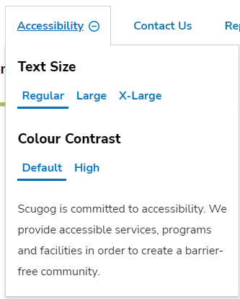

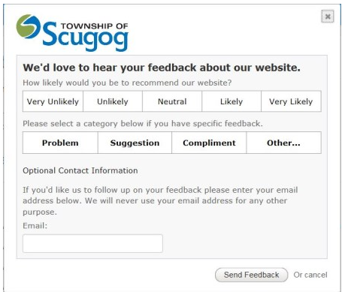

Accessibility
Notes:
Resident's can easily submit feedback through the online form or utilize accessible features on the website if needed
in early 2020 we did a website refresh to ensure our website was more accessible and user friendly
Online fillable forms (in progress & ongoing)
additional online fillable forms will be added to our website to make the submission of various forms quicker and easier, saving time and effort. E-Commerce will be incorporated where applicable
We are continue to add more online fillable forms to our website and incorporate e-comcmerce. Residents can now submit a Freedom of Information request online and pay for it in one transaction, immediately starting the processing time.

Slide 8

Township of Scugog ITSP & Five – Year Roadmap
Notes:
In fall of 2021, the Township retained a third-party consultant to develop an IT Strategy and Five-Year Roadmap. As digital services should really be designed with the customer in mind, the project team also consulted with the community through various means. Engagement through the “myscugog.ca” portal invited participants to share their thoughts or ideas as well as to participate in an online survey.
Over 184 responses were received from both residents and local businesses. A virtual Open House was held where the project team was able to focus in on some of the ideas to gain an even better perspective of the community requirements for digital services.
We are using what we heard to continue to enhance our customer service.

Slide 9
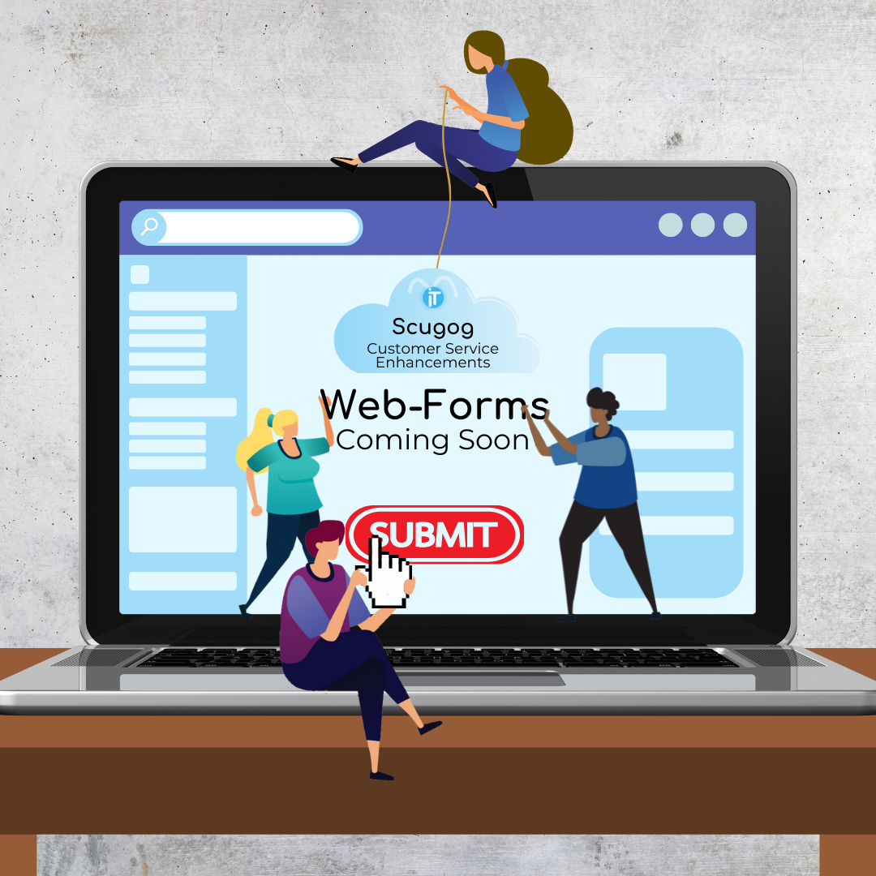


Slide 10

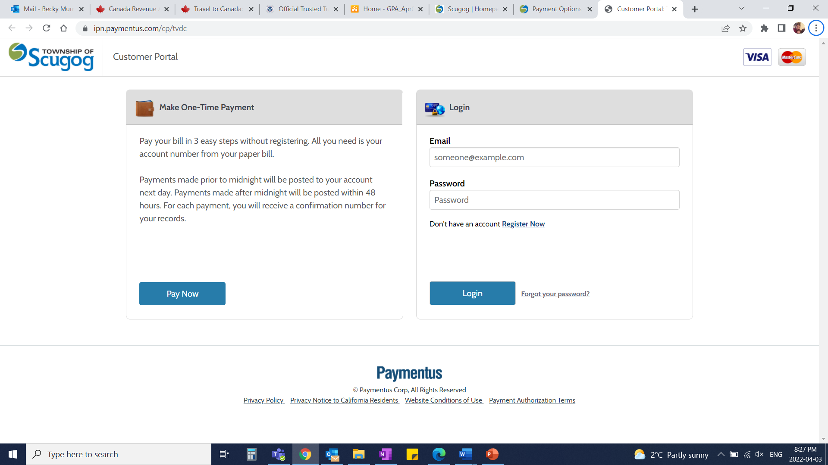
Online Payments
Notes:
The Township added online payments to the website.
Residents can now pay their property taxes and other services with your credit card using Paymentus, a third-party service provider, which enables credit card holders to make property tax payments with Visa, Mastercard, or American Express. There is a 2.5 per cent service fee payable to Paymentus in order to use this service.
In addition, some of our forms have e-commerce built into them.

Slide 11
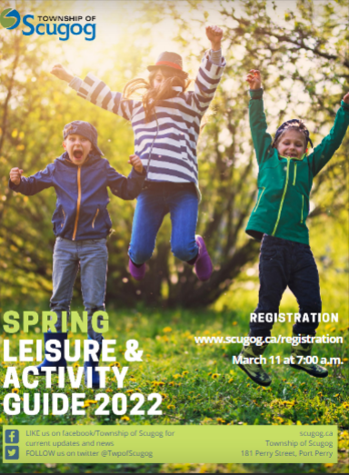
Recreation Programs
Notes:
Our recreation guide is now available online and residents can register for programs online all in one step through the use of Perfectminds

Slide 12
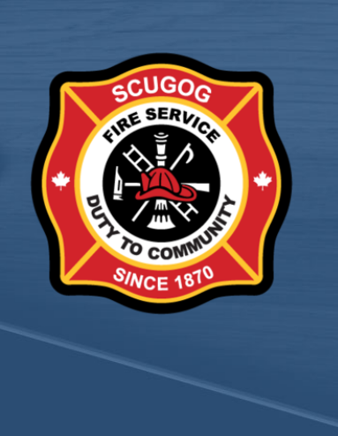
Online
Burn
Permits
Notes:
success of our newly implemented online burn permits – with almost 400 permits issued.

Slide 13
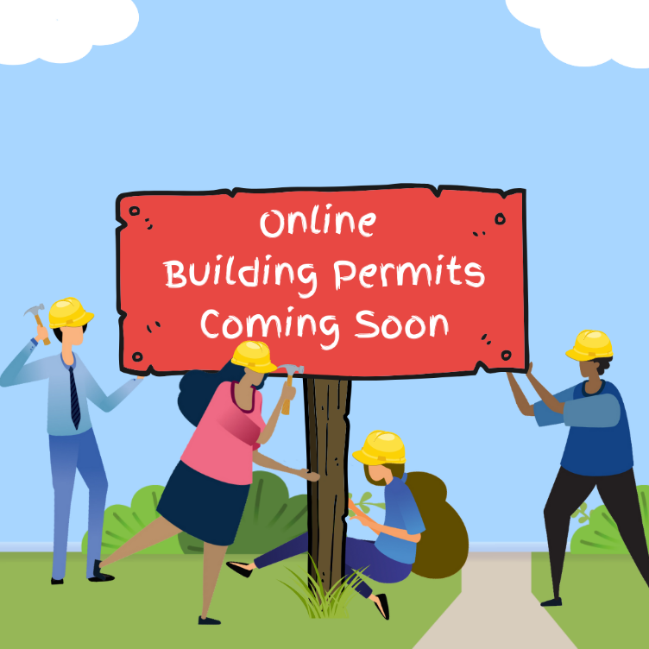

E – Permit
Online
Permits
Notes:
The Township of Scugog is starting the switch from older tech and paper-based systems to digital, starting with our new building e-permits – a permit that can be filled out entirely online!
These new building permits will provide a single point of contact to complete and track permits, allowing residents, contractors, and inspectors the access to easily check the status of their permits as well as follow-up on them and schedule inspections from one place!
Planning and by-law to follow later this year.

Slide 14


Conclusion
Continue to improve and enhance !
Faster response times
Journey
continued
Challenges
Efficiencies
Improved resident interaction
Feedback and identifying opportunities
14
Notes:
We will con’t to Harnessing technology to improve the customer experience

Slide 15

Coming
Soon
15
Notes:
***customer service survey***circle back to engage on How are we serving you….(journey con’t )
New Phone System
9 sites will be connected through 1 phone system
Residents will be able to call the main office and be connected to other facilities directly without having to hang up and call
For example you can call the SCRC to get information on the recreation program and than be transferred to the municipal office to get tax information and than transferred to fire department for information on your burn permit .
Self- serve Kiosks
Self-serve kiosks for residents will be implemented in the fall to make accessing online services onsite at our facilities quicker and easier.
Public input will be requested in the future
The Township will be implementing self service kiosks in some of our facilities later this year! This will allow residents to register for programs, look up information right in the facility.
Public input will be requested in the near future.
Hybrid Council meetings
We are making enhancements to our meeting rooms and council chambers to ensure we can offer resident seamless hybrid meeting options
Council Chambers will be done later this spring and the meeting rooms this summer. Stay tune for more information
Board Manager – coming soon – move to bottom
Allow tracking of all things related to our boards and advisory committees including terms of references, agendas, minutes and appointees
Online sign up for committees
CRM
Provide a single, user-friendly software solution to help modernize digital services to our residents and create efficiencies through improving backend and cross departmental processes.
The submission of various inquiries quicker and easier, saving time and effort for both the public and staff.
Residents will be able to track service request statuses online
Will integrate into the Region’s mydurham311 in the future
to provide a single, user-friendly software solution to help modernize digital services to our residents and create efficiencies through improving backend and cross departmental processes.
Residents will see the improvement of customer engagement, by phone, in person or online access. It will improve the ability to increase communication with customers, one stop resolution for many issues through easier access to digital and phone services, easier access to information for residents, quicker response times and ensure residents are able to track the status of service requests and the history of the request.
The CRM initiative will create efficiencies for service delivery through modernization and automation of business processes across all departments.
3 phases – basic CRM and customer portal by end of September 2022; additional features to be added in phase 2 than phase 3 integration with the Region’s myDurham311

Slide 16
THANKS!
Any questions?
Becky Jamieson, Director of Corporate Services/Clerk
Lori Bowers, Director of Community Services
To learn more visit
my.scugog.ca/customerservice

