Slide 1

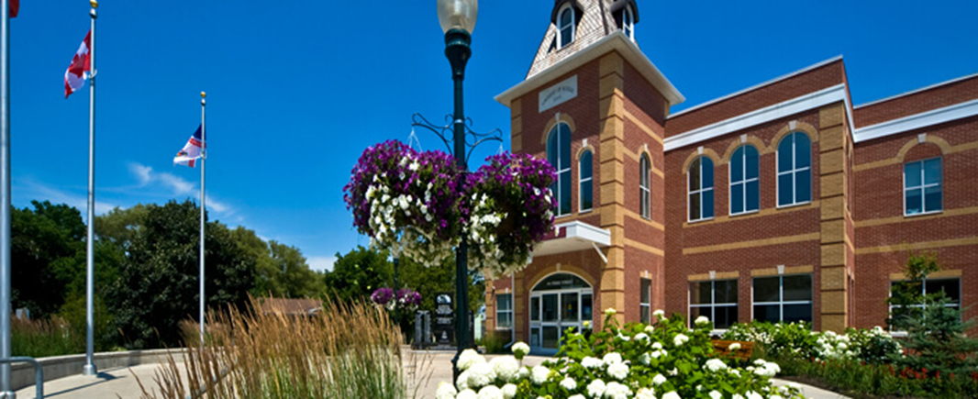
2021 Draft Operating Budget
Virtual Open House
February 8, 2021

Slide 2

Budget Road Map
June to September
Budget Timetable provided for Council Approval
Council Consultation for priorities
Commence Public Consultation on Capital and Operating Budget including feedback survey
November to December
Draft 2021 Capital Budget and 2022-2025 Capital Forecast presented
Public Feedback and Virtual Public Open House for Draft Capital
Final Capital presented for approval. Staff directed to review budget for 6% target
January to February
Line by line review of expenses, revenues, grants and economic changes impacting operating budget
Established COVID-19 reserve
Draft 2021 Operating Budget presented
Public Feedback and Virtual Open House for Draft Operating Budget
Final Operating Budget to be presented to Council for approval

Slide 3

Local Services Supported by Taxes
Fire and Emergency Services
Recreation Programs
Museum
Library
By-Law Enforcement
Economic Development
Community Development
Heritage Preservation
Committee Expense Funding
Maintenance of Roads and Sidewalks – including Winter Control
Licenses and Permits
Crossing Guards
Infrastructure Construction/Replacement
Tourism
Growth Management

Slide 4









Delivering Value to Taxpayers
826 lane KM
road maintained in winter
27 km of sidewalks and trails
15 parking lots
15 winter maintenance vehicles
19 Parks
15 Playgrounds
12 ball diamonds
199 acres of parkland and open space
Splashpad, dog park, skate parks
Fire Protection
2 fire stations
11 apparatus
64 fire fighters
> 50 community events attended annually
> 300 fire safety inspections annually
445 emergency calls on average annually
Recreation Programs
Fitness and wellness 1,240
Day camp 1,225
Swimming lessons/ public swimming 4,500
Community events 40+
Museum
Admissions 3,500
Event, exhibits, programs 10
Student attendance 400
Facilities
2 Recreation Complexes
3 Ice Pads
10 Community Halls
Town Hall 1873
500 Building Permits
Public Library
142,000 annual library visits
15,700 computer users
39,000 wi-fi users
9,000 program attendance
500 children in summer reading club

Slide 5

Total Taxes Paid by a Typical Household
47%
9%
44%
Durham Region
Services
5%
1%
School Boards
3%
Scugog Services
Federal Provincial Municipal

Slide 6





Distribution of Residential Tax Bill
Education
30% of the property tax bill is collected by Scugog to provide services.
Region of Durham

Slide 7

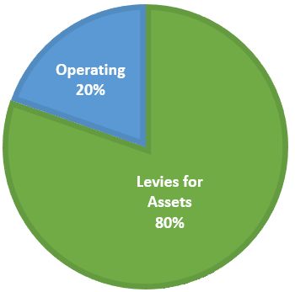



2021 DRAFT Operating Budget
Majority of 4.98% increase relates to taking care of our assets.
Service Delivery
Investment in Assets:
3% for Roads
0.5% for Vehicles &
Equipment
0.5% for Building &
Facilities

Slide 8
Significant Items Impacting 2021 Budgets
Roads and Infrastructure budget allocation – $406,335
Vehicle & Equipment and Building & Facilities allocation – $135,465
Salary cost of living per collective agreement – $120,000
Overall projected increase in benefit costs – $32,000
Increase in WSIB rate for all staff – $40,000
Reduction of investment income rate – $125,000
Inflationary increases on road maintenance material – $69,800
Other outside pressures identified – $112,000

Slide 9


COVID -19
Uncertainty of how the pandemic will continue
Budgeted 2021 as if it were a normal year to ensure funding will be available to continue service delivery after the pandemic ends
Proactively mitigated pandemic impacts in 2020 so the funds received from the Provincial Government were able to be moved into a reserve for 2021

Slide 10

Assessment Growth
Sum of all the changes that happen to the Township’s assessment base during the year including: New Construction, Major renovations, Demolitions and Property value appeals
Allows additional revenue to be raised from taxation without any budgetary increase on existing properties
Should be used to help pay for growth (partially fund the Major Facility Reserves and to fund for future staffing)
For 2021 the full amount was used to fund the operating budget
Estimated funds raised from additional growth for 2021 is $224,000

Slide 11

User Fees
Fees and charges are reviewed every year and are compared to similar municipalities as well as those in the Durham Region
The updated fee amounts that were approved by council were included in the draft operating budget
Several new fees were considered but were not recommended due to the impact on the user and the acceptance of the residents
Increased user fees will be required in the future to help with the ongoing pressures facing the Township

Slide 12



Assets / Infrastructure
Township’s replacement value of assets - $465 million
  Majority of these are roads - $393 million
September 2019 SOTI report identified $190 million deficit related to roads
Special levies were introduced in 2014 to help with this deficit and to ensure the roads are kept safe and usable for our residents
Special levies are expected to continue for the foreseeable future

Slide 13
Ongoing Challenges to Maintain Township Assets

Slide 14
Roads and Other Infrastructure Annual Levies

Slide 15

Investment in Roads for 2021
Operating $4,464,700
Capital $4,962,000
Total $9,426,700
$309,100 more than 2020

Slide 16
Savings and Increased Non-Tax Revenues
Core Services and Efficiency Review Savings
  Reduction in contracted grader costs - $13,800
  Reduction in bank fees and charges - $15,440
  Reduction in winter maintenance contracted service - $55,300
  Reduction in minutes of settlement (ARB activity) - $55,000
Non-tax Revenues
  Increase in Canada Summer Grant - $86,600
  Increase in burn permit revenue - $21,500
  Increase in recreation user fees - $22,000

Slide 17
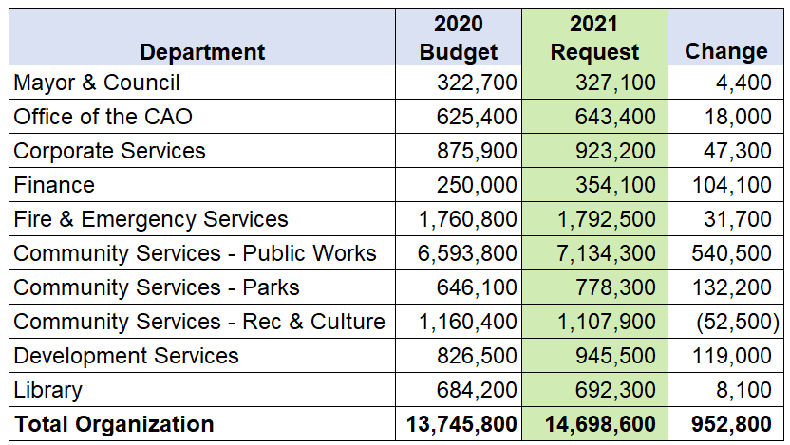
2021 DRAFT Operating Budget Net
Impact by Department
2021 Net Operating Budget proposed - $14,698,600

Slide 18



Where does the Money Come From to Pay for Services

Slide 19
Tax Burden by Property Class

Slide 20
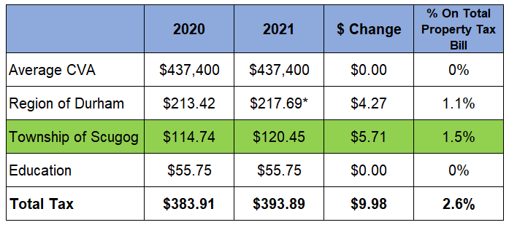
2021 DRAFT Operating Budget
Monthly Increase in Total Average Residential Tax Bill
* The Region of Durham’s amount is only an estimate at this time.

Slide 21
Taxes per month ($120.45)

Slide 22

Accomplishments in 2020
COVID-19 Emergency Response - implemented Safety Plans to ensure services continued while protecting the health of the public and staff
Extended season for seasonal patios
Completed of the Township Wide Speed Limit Review
Proactively managed expenditures to ensure no deficit as a result of COVID-19 pandemic
Launched My Scugog, Our Community Engagement Site improving resident feedback and civic participation
Port Perry Waterfront Action Plan - 3 Concept Plans, substantial public consultation process, preparation of an Emerging Preferred Plan
Reviewed and Issued approximately 500 building permits which is a 66% increase over a typical year
Community Improvement Plan (CIP) approved for Employment Lands
Continued to modernize technology, introduced virtual programming and virtual council meetings
Increased communications outreach through social media and mayor update videos
By-law Enforcement Patrol hours/enforcement substantially increased during the initial COVID lockdown to ensure coverage 7 days a week
Launched popular online versions of regular Library programs and activities using Facebook Live, Zoom and YouTube (143 programs have been delivered online since March 2020)
Introduced new Self-Checkout kiosk & phone app to allow patrons to check out their own materials more safely
Delivered fire safety education to all schools
ZERO fire fatalities

Slide 23
Coming up in 2021
Continuing to keep our community safe during COVID-19 and providing facilities for mass vaccination implementation
Port Perry Waterfront Action Plan Final Report
Open Streets task force
Cannabis policies and regulations
Refresh of Scugog.ca for accessibility and improved user experience
Secondary Suite policies and regulations
Port Perry Downtown Community Improvement Plan
Completion of the Active Transportation and Transportation Master Plan
New service delivery method for winter maintenance of parking lots
Conversion of tendering process to online bids
Expanding By-Law enforcement to meet needs of community for nights and weekends
Increased resources to help process the increased number of building permits for 2020 and 2021
Modernizing phone system
Expanding virtual services and programming
Completion of the Roads Maintenance Modernization Review

Slide 24
Future Challenges
Annual pressures each year
  Inflation
  Growth
  Infrastructure
  External Influences (legislative etc.)
COVID – 19 ……?
Community expectation for service delivery
  Service Levels
  Programs
  E-services
  Strategic Plan Deliverables
Invest in foundational aspects for the Township
  Technology
  People
  Business Processes
  Assets

Slide 25

2021 DRAFT Operating Budget
  Thank you
  This presentation will be available on our Township Website at www.scugog.ca
  Terri Barton, CPA, CGA
  Manager of Finance
  tbarton@scugog.ca

